Slide 1
Hands-on tutorial on data assimilation using Markov state model and Hidden Markov models
Yasuhiro Matsunaga
ymatsunaga@mail.saitama-u.ac.jp

Slide 2
What can we learn?
We will learn basics of integrating experimental data to MD simulation data using Markov state model (MSM) and Hidden Markov state model (HMM)
Starting from an introduction to our Julia package (MDToolbox.jl), we will learn basics of MSM and HMM using simple examples. Then, we will combine MSM and HMM for incorporating experimental data.

Slide 3
Schedule
13:00 Installation. Julia and MDToolbox.jl basics
Introduction to our in-house Julia package MDToolbox.jl
14:00 Markov state model (MSM) basics
What is MSM?, and how to construct it
14:40 Hidden Markov model (HMM) basics
What is HMM? and what can we do with it
15:20-16:00 Data assimilation with MSM & HMM

Slide 4
00 Installation. Julia and MDToolbox.jl basics
Let’s follow the descriptions of README at https://github.com/matsunagalab/hmm_tutorials
Install Jupyter Lab
Install Julia and packages
Install Julia
Install required packages including MDToolbox.jl (or update)
Run Ijulia
Download tutorial materials

Slide 5
MDToolbox.jl
Julia package for the statistical analysis of MD trajectories
https://github.com/matsunagalab/MDToolbox.jl
I/O for trajectory, coordinate, and topology files
Atom selections
Least-squares fitting of structures, and some geometry calculations
Potential mean force (PMF) or free energy profile from scattered data
Statistical estimates (WHAM and MBAR methods) from biased data
Dimensional reductions (Principal Component Analysis, and others)
Markov state models and Hidden Markov models

Slide 6
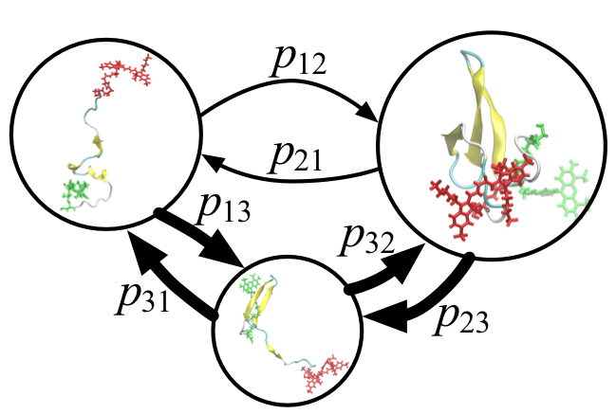
01 Markov state model basics
What is MSM? MSM is a statistical model to describe conformational dynamics of molecules
Structures are clustered into discrete states
Dynamics are represented by
transition probabilities between states
Time is coarse-grained in τ
🤗 Dynamics is represented by parameters T(τ)
🤗 Long time dynamics from multiple short simulations
😞 Force-field dependence (Incorrect dynamics)

Slide 7
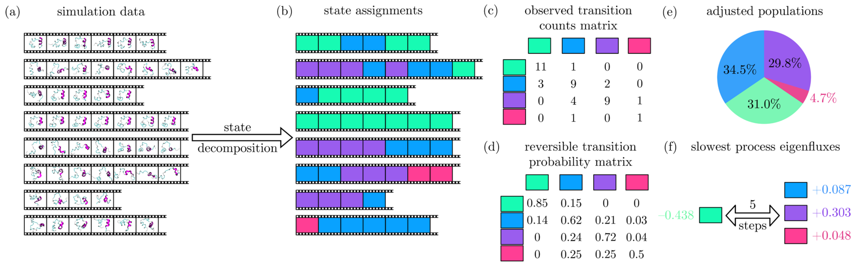
Construction of MSMs
B. E. Husic, V. S. Pande, Markov State Models: From an Art to a Science. J. Am. Chem. Soc. 140, 2386–2396 (2018).

Slide 8
Typical computations for constructing MSMs
MDToolbox functions
Load MD trajectory
mdload()
Feature extraction (distance-map, contact-map) and Dimensional reduction (PCA, tICA)
compute_distancemap()
pca()
tica()
Clustering (k-centers, k-means) for defining states
clusterbykcenter()
Count transitions and estimates transition probabilities
msmcountmatrix()
msmtransitionmatrix()
Validation through implied timescales or others
msmimpliedtime()

Slide 9
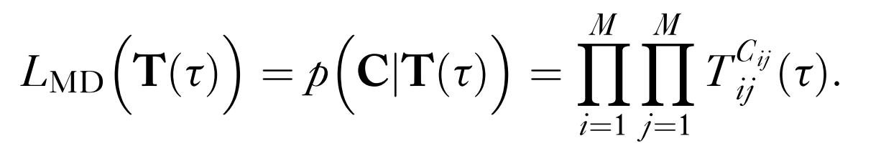
Estimation of transition probabilities from counting matrix: Maximum likelihood
Maximize this function over T(τ)
K. A. Beauchamp, G. R. Bowman, T. J. Lane, L. Maibaum, I. S. Haque, V. S. Pande, MSMBuilder2: Modeling Conformational Dynamics on the Picosecond to Millisecond Scale. J. Chem. Theory Comput. 7, 3412–3419 (2011).
Y. Matsunaga, Y. Sugita, Use of single-molecule time-series data for refining conformational dynamics in molecular simulations. Curr. Opin. Struct. Biol. 61, 153–159 (2020).

Slide 10
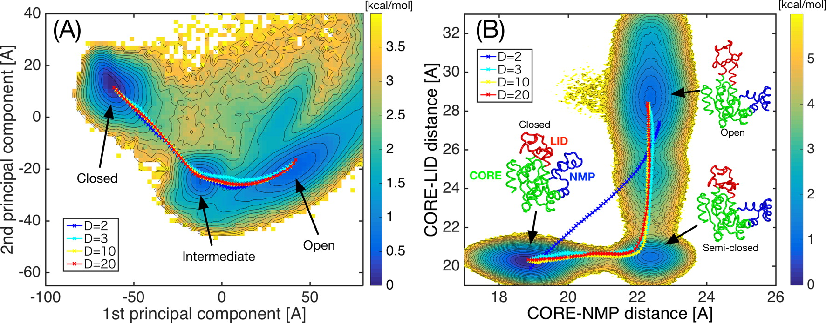
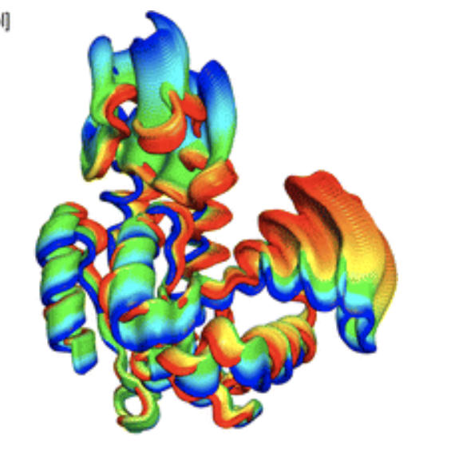
MD data in the tutorial
Coarse-grained (DoME-model) model of Adenylate kinase, simulated by GENESIS
C. Kobayashi, Y. Matsunaga, R. Koike, M. Ota, Y. Sugita, Domain Motion Enhanced (DoME) Model for Efficient Conformational Sampling of Multidomain Proteins. J. Phys. Chem. B. 119, 14584–14593 (2015).
Y. Matsunaga, Y. Komuro, C. Kobayashi, J. Jung, T. Mori, Y. Sugita, Dimensionality of Collective Variables for Describing Conformational Changes of a Multi-Domain Protein. J. Phys. Chem. Lett. 7, 1446–1451 (2016).

Slide 11
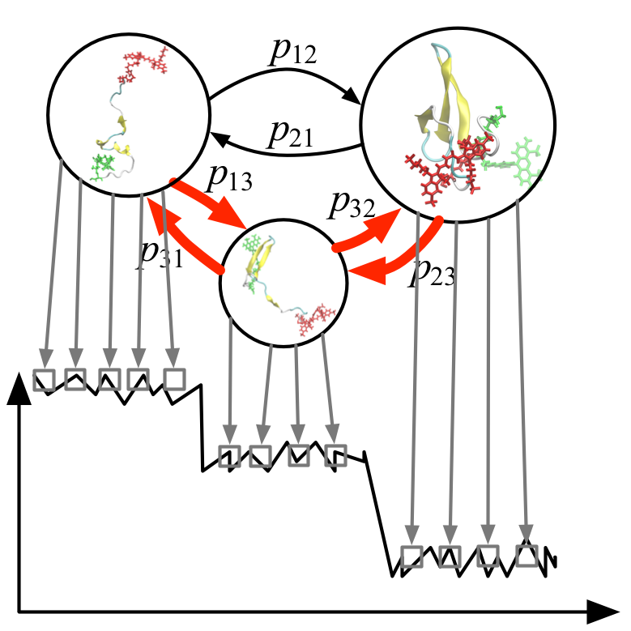
02 Hidden Markov model basics
What is HMM? MSM is a latent MSM behind experimental observations
HMM
Experimental
observations
FRET Efficiency
Time

Slide 12





Toy model used in the tutorial
Daily weathers
Sunny
Sunny
Sunny
Sunny
Cloud
Cloud
Cloud
Cloud
Hidden Markov
Model
Rain
Rain
Rain
Rain
Can we estimate daily weathers
Or transition probabilities
from daily ice-creams sales
Time-series data?
Daily Ice-cream sales
Experimental
observations
2.3
3.5
3.2
0.5

Slide 13
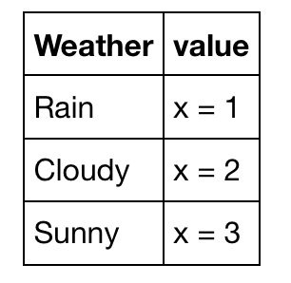
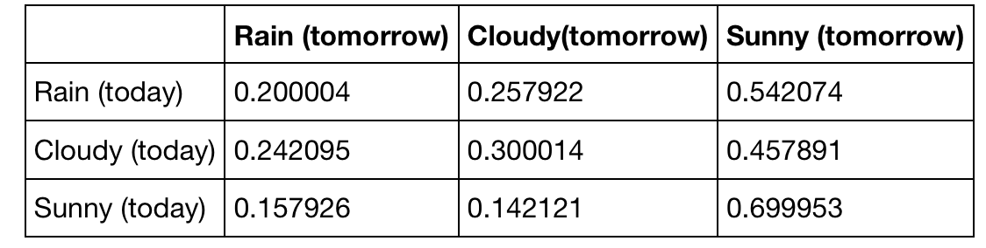
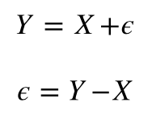
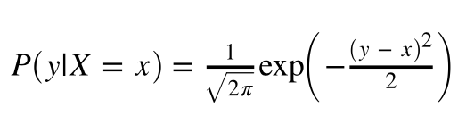
Toy model used in the tutorial (cont’d)
Transition probabilities of daisy weathers
Probabilities to observe specific daily sales values given weathers
sales
weathter
Gaussian noise
sales
weathter

Slide 14
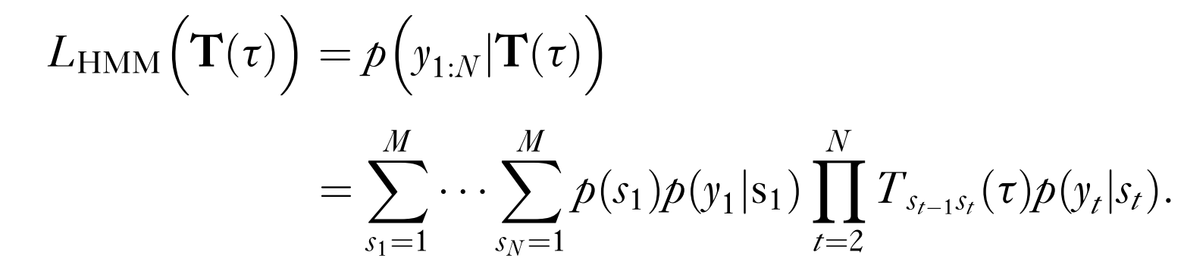
Estimation of latent states and transition probabilities from counting matrix: Maximum likelihood
Updated
Maximize this function over states or T(τ)
Viterbi algorithm estimates states
Baum-Welch algorithm estimates T(τ)
Y. Matsunaga, Y. Sugita, Use of single-molecule time-series data for refining conformational dynamics in molecular simulations. Curr. Opin. Struct. Biol. 61, 153–159 (2020).

Slide 15
03 Data assimilation with MSM and HMM
What is the purpose of integrating MD data and HMM data?
Correct MD data ensemble or dynamics matching with experimental data
Interpret experimental data in terms of structural details
Structural information
Correct information
Simulation data
Experimental data
Atomic detail Incorrect dynamics Short time-scale
Lack of structural detail Accurate ensemble/dynamics Long time-scale

Slide 16
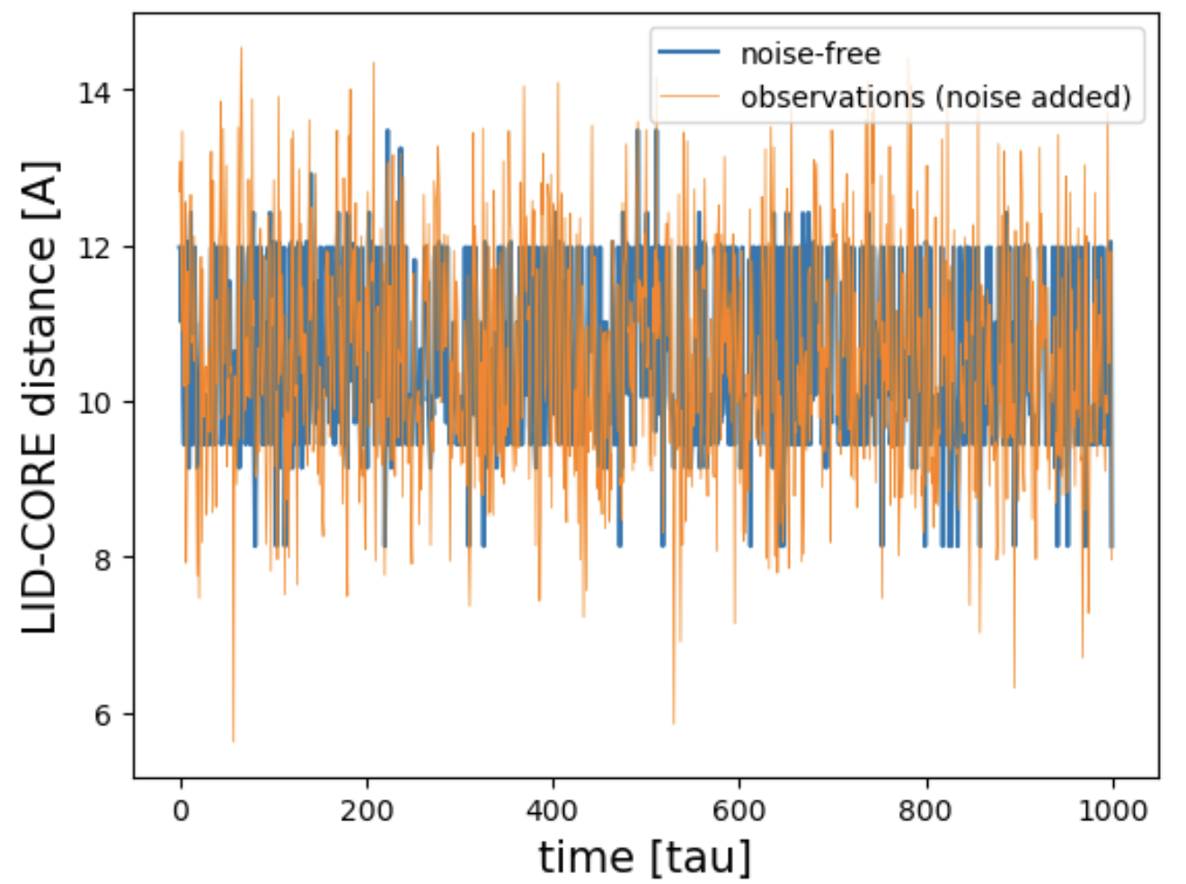
”Experimental data” in the tutorial
Using the original MSM, we generate LID-CORE distance time-series as ”experimental data” mimicking single-molecule FRET

Slide 17
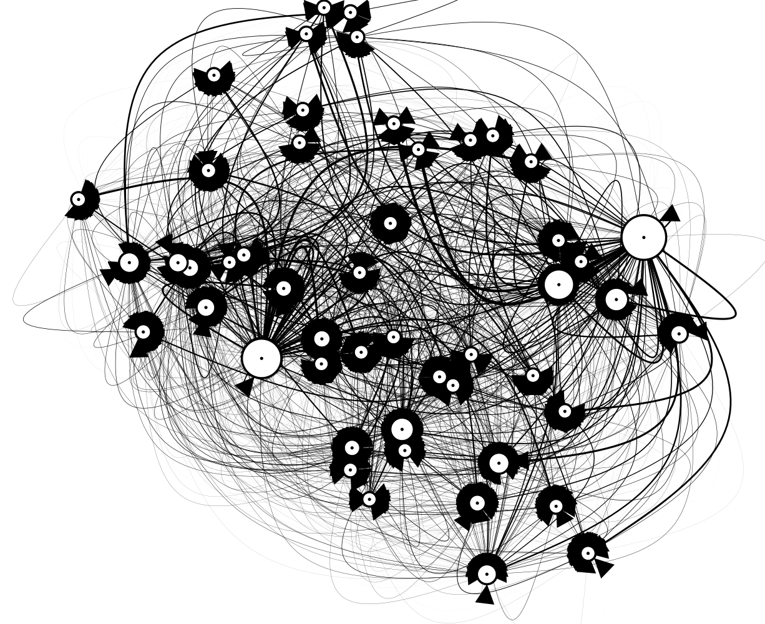
”Experimental data” in the tutorial (cont’d)
Transition probabilities of MSM’s states
Probabilities to observe specific daily sales values given weathers
observation
LID-CORE
distance
Gaussian noise
observation
LID-CORE
distance

Slide 18
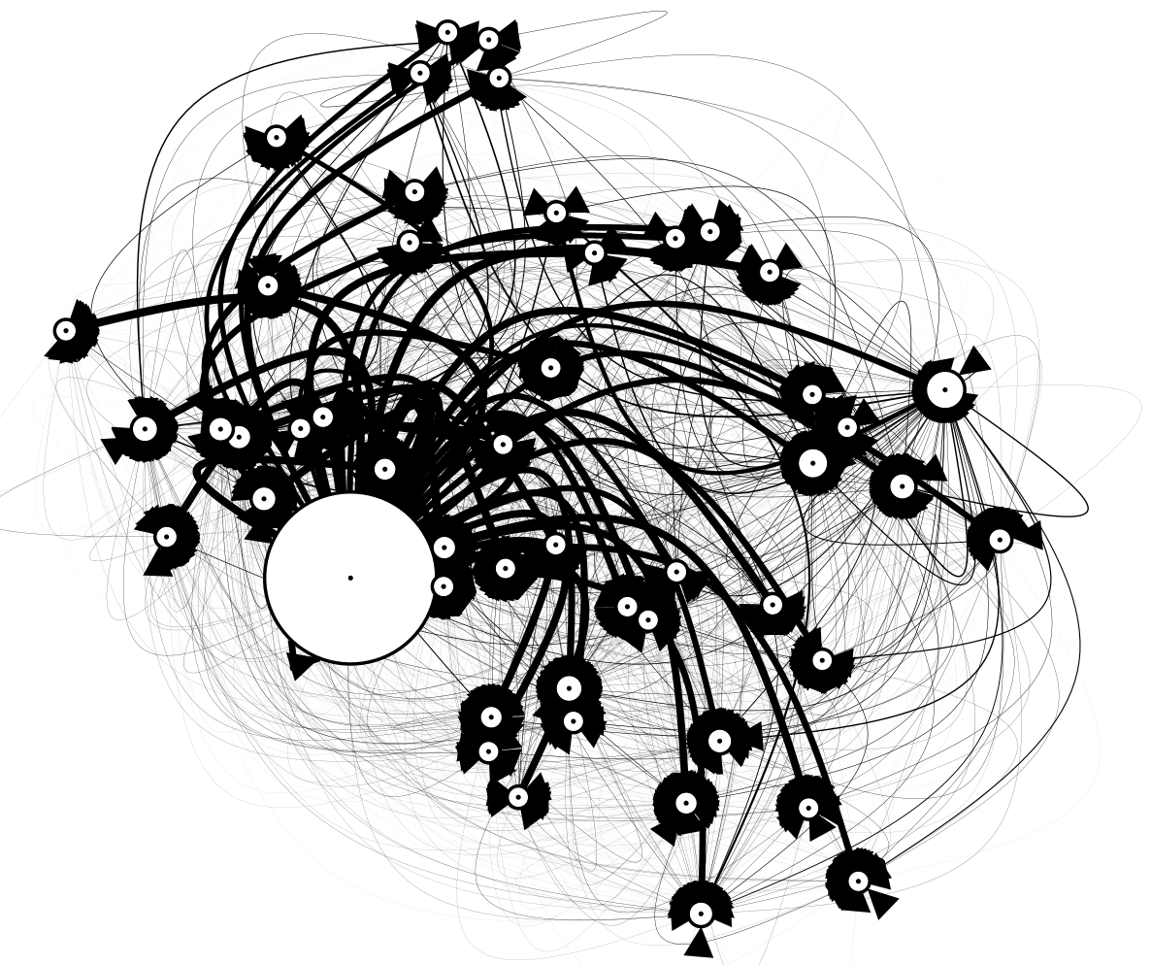
Problem setting in the tutorial
“Distorted” MSM
Can we correct the “distorted” MSM
and restore the original MSM?
“experimental data” generated by the original MSM
Data assimilation
or integration

